Slide 1
Mining Inter-transaction Association using Templates
Bidit Sadhukhan
B2230022
Data Mining

Slide 2
Inter & Intra Transaction Association
Inter Transaction
Intra Transaction
Inter-transaction patterns involve relationships between different transactions or records in a dataset.
Laptops and antivirus software are often purchased together by different customers across various transactions reveals an inter-transaction pattern.
Association Rule- If the prices of IBM and SUN go up, Microsoft’s will most likely go up the next day.
Helpful for discovering patterns or trends that span multiple transactions, providing insights into customer behavior over time.
Focuses on patterns within individual transactions.
A customer buys a laptop and a laptop bag, the association between these two items within the same transaction is an intra-transaction pattern.
Association Rule-When the prices of IBM and SUN go up, the price of Microsoft will most likely go up on the same day.
Useful for understanding item co-occurrences within individual transactions, often applied in market basket analysis.

Slide 3
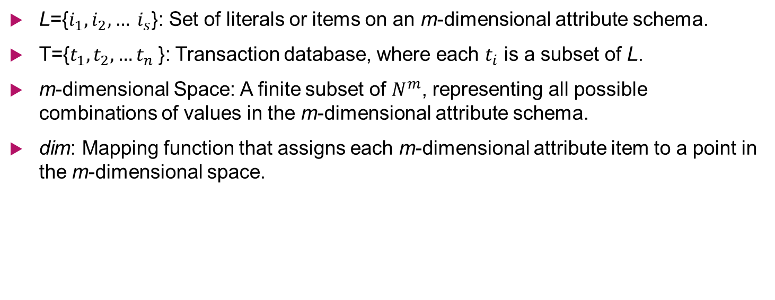
Useful Notations
L={$i_{1},i_{2}, … i_{s}$​}: Set of literals or items on an m-dimensional attribute schema.
T={$t_{1},t_{2},…t_{n}$}: Transaction database, where each $t_{i}$ is a subset of L.
m-dimensional Space: A finite subset of $N^{m}$, representing all possible combinations of values in the m-dimensional attribute schema.
dim: Mapping function that assigns each m-dimensional attribute item to a point in the m-dimensional space.

Slide 4
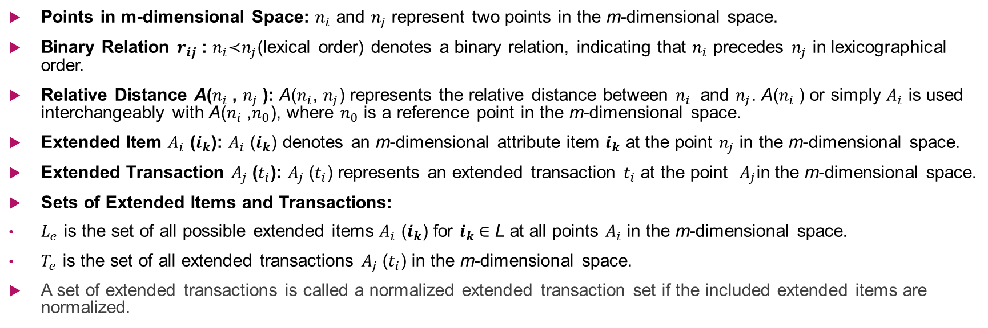
Notations-II
Points in m-dimensional Space: $n_{i}$ and $n_{j}$ represent two points in the m-dimensional space.
Binary Relation $r_{ij}$ : $n_{i}$​≺$n_{j}$(lexical order) denotes a binary relation, indicating that $n_{i}$​ precedes $n_{j}$​ in lexicographical order.
Relative Distance A($n_{i}$​, $n_{j}$​): A($n_{i}$, $n_{j}$) represents the relative distance between $n_{i}$ and $n_{j}$. A($n_{i}$​) or simply $A_{i}$ is used interchangeably with A($n_{i}$,$n_{0}$), where $n_{0}$ is a reference point in the m-dimensional space.
Extended Item $A_{i}$ ($i_{k}$): $A_{i}$ ($i_{k}$) denotes an m-dimensional attribute item $i_{k}$ at the point $n_{j}$ in the m-dimensional space.
Extended Transaction $A_{j}$​($t_{i}$): $A_{j}$​($t_{i}$) represents an extended transaction $t_{i}$ at the point ​ $A_{j}$in the m-dimensional space.
Sets of Extended Items and Transactions:
$L_{e}$​ is the set of all possible extended items $A_{i}$ ($i_{k}$) for $i_{k}$∈ L at all points $A_{i}$ in the m-dimensional space.
$T_{e}$​ is the set of all extended transactions $A_{j}$​($t_{i}$) in the m-dimensional space.
A set of extended transactions is called a normalized extended transaction set if the included extended items are normalized.

Slide 5
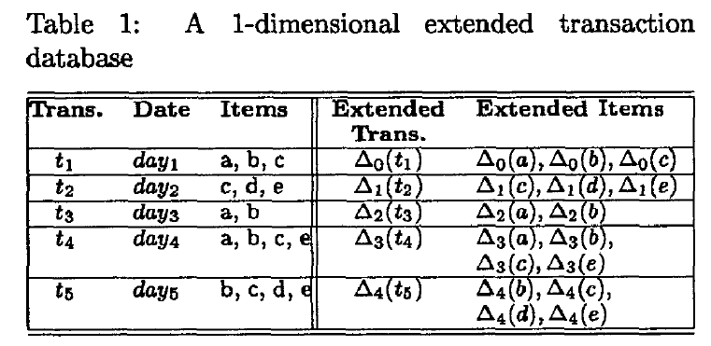
Multidimensional Extended Transaction
A simple traditional database is transformed
into a 1-dimensional extended transaction database as shown in Table 1, through a mapping function which maps day i onto a point i-1 in the 1-dimensional space.

Slide 6
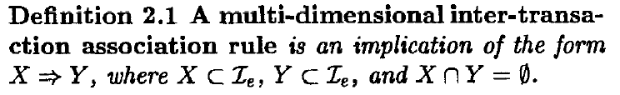
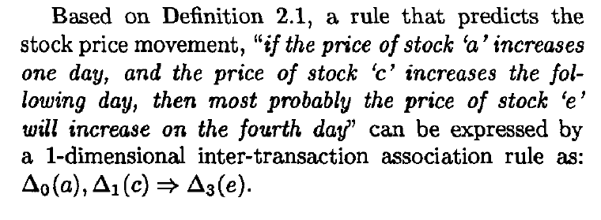
Definition

Slide 7
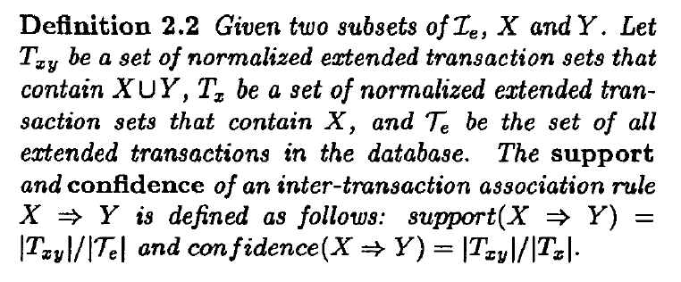
Definition-II

Slide 8
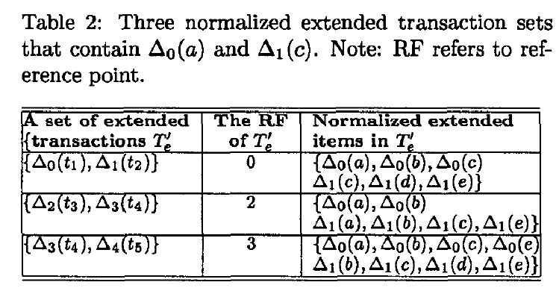
Calculations of Support and Confidence

Slide 9
Template Model
Motivation
Association rule mining often results in a large number of rules.
The abundance of rules poses challenges for users to identify relevant patterns.
The computational cost increases with a growing number of rules.
To address user-related challenges and control computational costs, there is a need to restrict the search space for association rules.

Slide 10
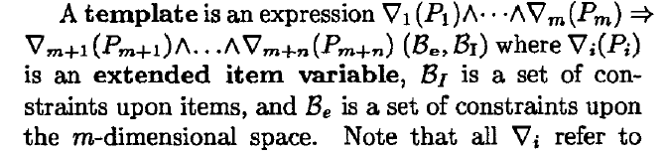
Template Model

Slide 11
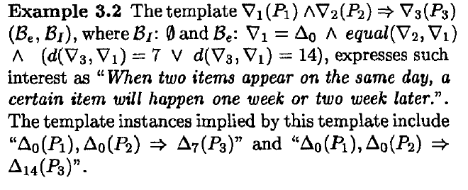

Slide 12
Mining Process using templates
Template Interpretation- Before starting mining process, we need first interpret and translate template, which is conveyed by a boolean expression, into template instance(s) as above so as to provide guidance for mining algorithms.
Mining Planning- Like traditional association rule mining, we first discover large extended itemset, and then derive rules from these large itemset.
Large Itemset Recovery- In this phase, we find the set of all large extended itemsets identified in previous stage.
Association Rule Generation- Using the large itemsets, we can find the desired inter-transactionassociation rules.

